Slide 1

Analysis of Golf Pro’s KPI’s
Nikolas Argiropoulos

Slide 2
outline
Origins of Golf
Limitations of Sports analytics in Golf
Goal
Description of variables
Method
Results/Conclusions
Questions
Statistical Models

Slide 3

Origins of golf

Slide 4
No tracking data
Only event data
Lack of multivariate analysis
Limitations of sports analytics in golf

Slide 5
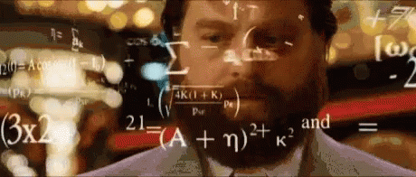
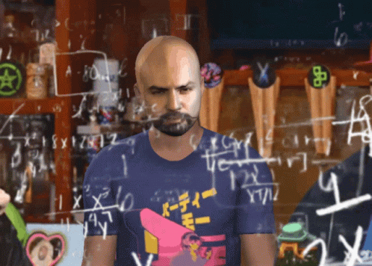
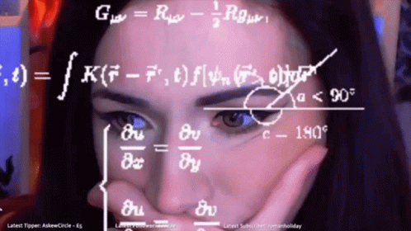

Slide 6
To measure if 4 main KPI of a golfer’s game predicts GIR, bogey average and scoring average.
If these 4 main KPI do predict GIR, bogey average and scoring average, which of the 4 KPI should Golfers improve to score lower and win more tournaments.
Goals

Slide 7
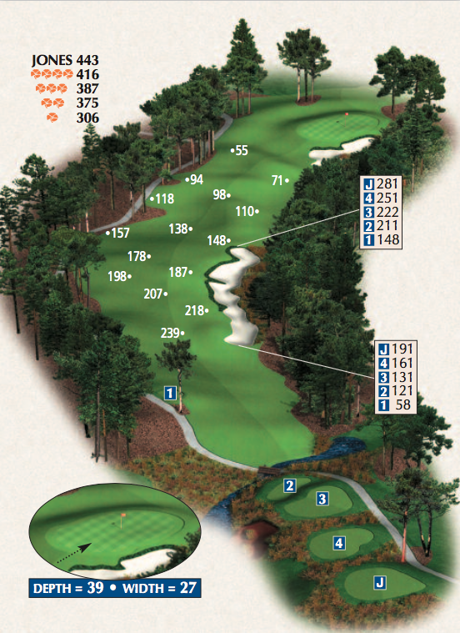
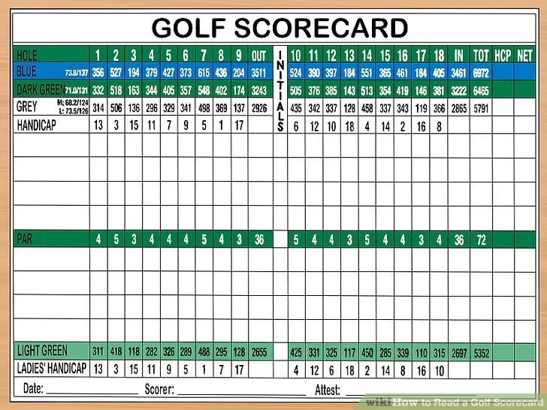
Variables of interest
Top Tens
Greens in Regulation (GIR)
Bogey Average
Scoring Average
Average Driving Distance
Average Driving Accuracy %
Approaches <100yards
Approaches >100yards
Notes:
The distance between the hole and the ball on shots that took place within 100 yards from the hole.

Slide 8
methods
PGA tour data from 2015-2019 (5 years)
Normality and multicollinearity tests for linear regression assumptions
Multivariate multiple linear regression
Partial η²

Slide 9
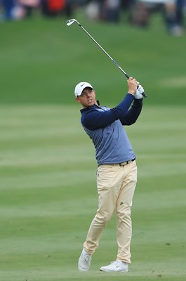
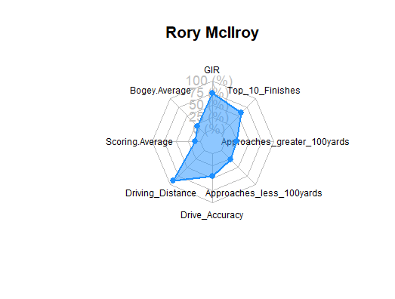
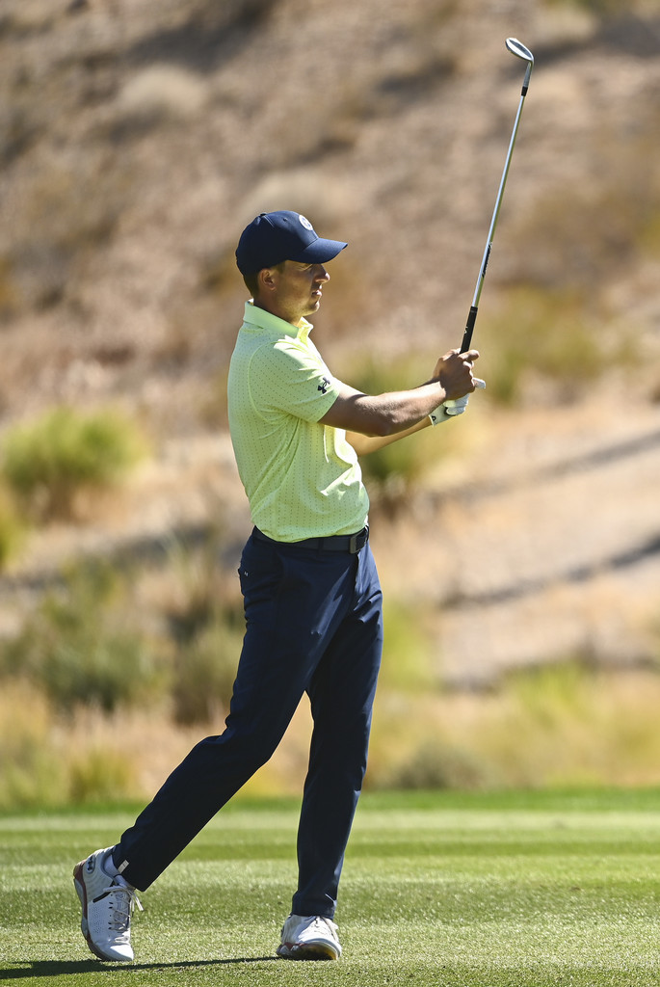
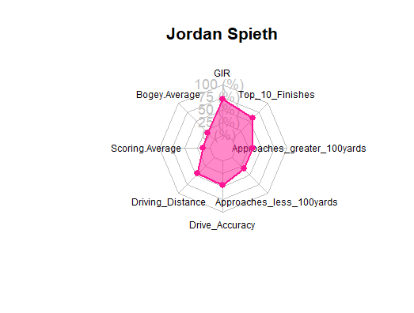
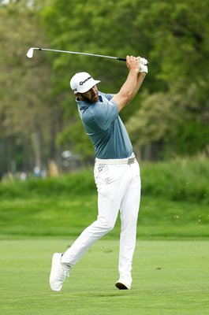
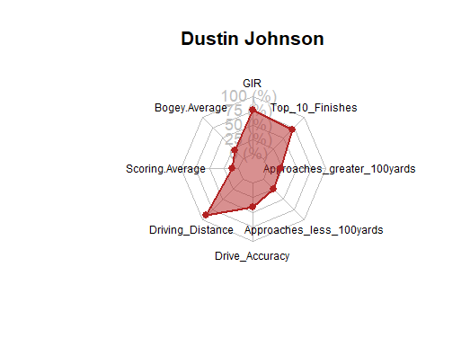
Results

Slide 10
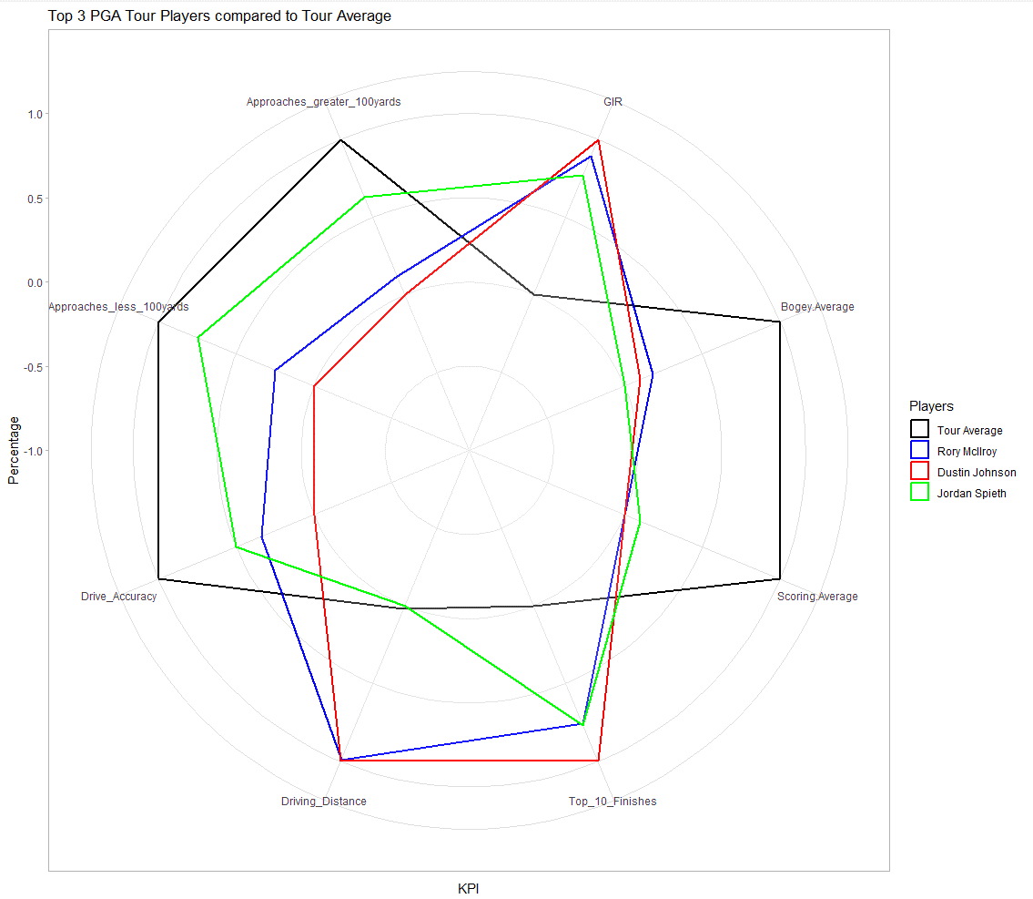
Results Cont.

Slide 11
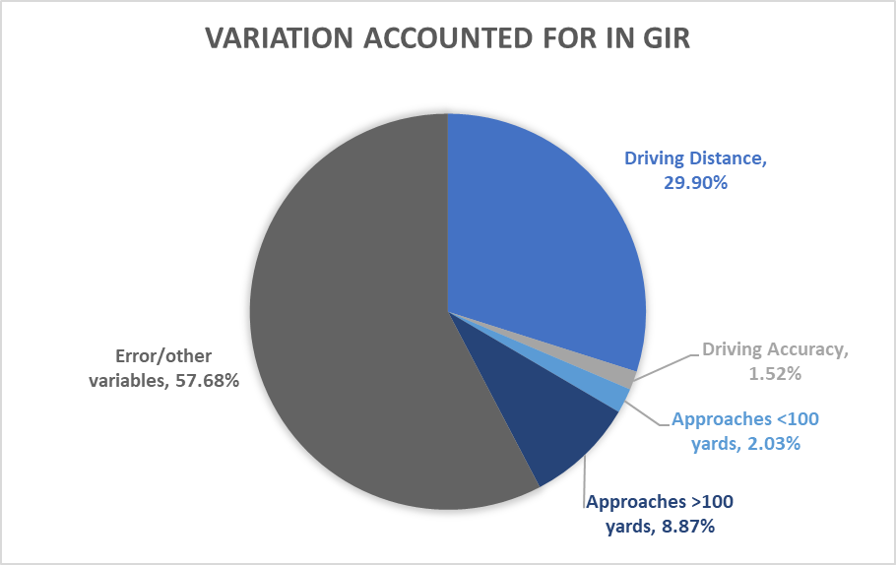
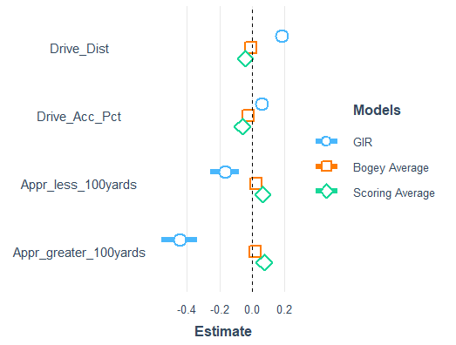
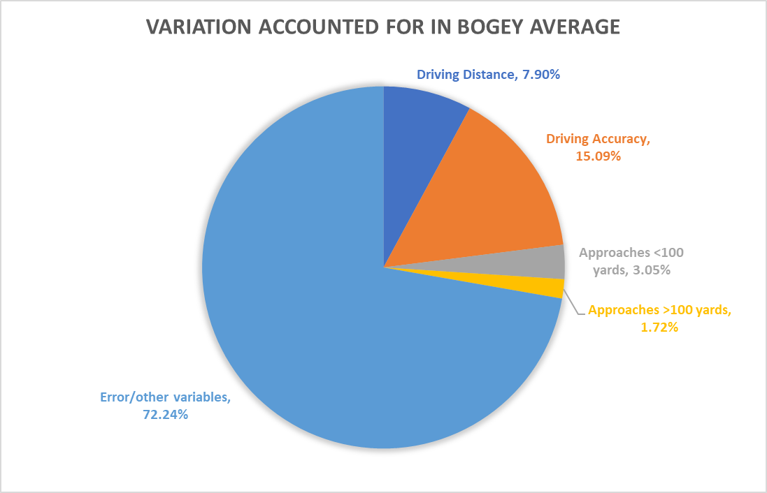
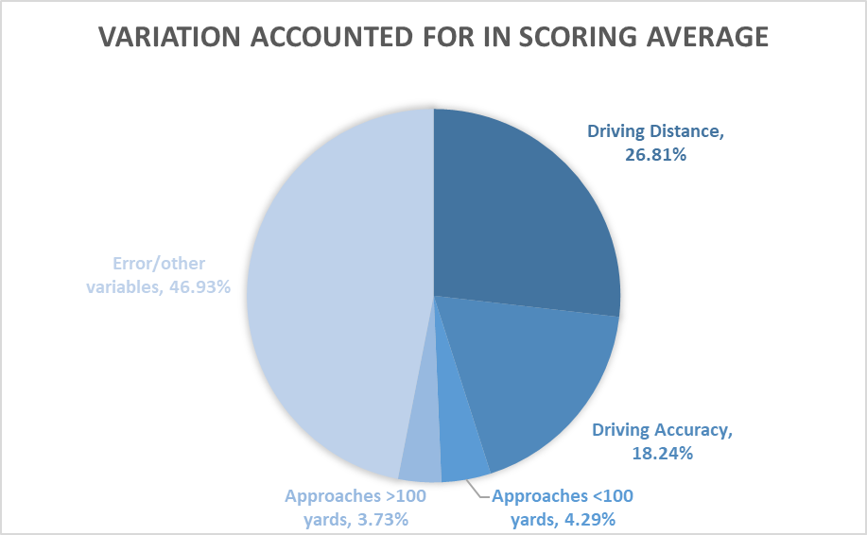
Results Cont.

Slide 12
Conclusions
GIR focus on DRIVING DISTANCE and APPROACHES < 100 YARDS.
BOGEY AVERAGE focus on DRIVING ACCURACY and DRIVING DISTANCE.
SCORING AVERAGE focus on DRIVING DISTANCE and DRIVING ACCURACY.
Independent Variable | GIR (increase) | Bogey Average (decrease) | Scoring Average (decrease)
Driving Distance (higher) | INCREASE | DECREASE | DECREASE
Driving Accuracy (higher) | INCREASE | DECREASE | DECREASE
Approaches <100 (lower) | DECREASE | INCREASE | INCREASE
Approaches >100 (lower) | DECREASE | INCREASE | INCREASE

Slide 13

Thank you!
Questions?

Slide 14
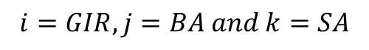
Multivariate multiple linear regression output
$$y_{i,j,k}= {β_{1,i,j,k}DD}_{1}+{β_{2,i,j,k}DA}_{2}+{β_{3,i,j,k}APLH}_{3}+{β_{4,i,j,k}APGH}_{4}$$
$$i=GIR, j=BA and k=SA$$
Observations: 658
Dependent Variable: GIR
MODEL FIT:
F(4,653) = 107.733, p = 0.000
R² = 0.398
Adj. R² = 0.394
---------------------------------------------------------------------
Est. 2.5% 97.5% t val. p
--------------------------- -------- -------- -------- -------- -----
(Intercept) 36.511 27.370 45.653 7.843 0.000
Driving Distance 0.184 0.163 0.206 16.687 0.000
Driving Accuracy% 0.062 0.024 0.100 3.175 0.002
Approaches <100yards -0.168 -0.257 -0.078 -3.679 0.000
Approaches >100yards -0.446 -0.556 -0.336 -7.975 0.000
---------------------------------------------------------------------
Observations: 658
Dependent Variable: Bogey Average
MODEL FIT:
F(4,653) = 45.051, p = 0.000
R² = 0.216
Adj. R² = 0.211
------------------------------------------------------------------------
Est. 2.5% 97.5% t val. p
--------------------------- -------- -------- -------- --------- -------
(Intercept) 5.613 4.612 6.614 11.014 0.000
Driving Distance -0.009 -0.011 -0.007 -7.484 0.000
Driving Accuracy% -0.023 -0.027 -0.019 -10.774 0.000
Approaches <100yards 0.023 0.013 0.032 4.532 0.000
Approaches >100yards 0.021 0.009 0.033 3.376 0.001
------------------------------------------------------------------------
Observations: 658
Dependent Variable: Scoring Average
MODEL FIT:
F(4,653) = 92.132, p = 0.000
R² = 0.361
Adj. R² = 0.357
------------------------------------------------------------------------
Est. 2.5% 97.5% t val. p
--------------------------- -------- -------- -------- --------- -------
(Intercept) 84.202 81.835 86.569 69.860 0.000
Driving Distance -0.044 -0.050 -0.039 -15.467 0.000
Driving Accuracy% -0.061 -0.071 -0.051 -12.071 0.000
Approaches <100yards 0.064 0.041 0.087 5.408 0.000
Approaches >100yards 0.073 0.044 0.101 5.030 0.000
------------------------------------------------------------------------
Independent Variable | GIR | Bogey Average | Scoring Average
Driving Distance | Partial η² = 0.2989 | Partial η² = 0.0789 | Partial η² = 0.2681
Driving Accuracy | Partial η² = 0.0152 | Partial η² = 0.1509 | Partial η² = 0.1824
Approaches <100 | Partial η² = 0.0203 | Partial η² = 0.0304 | Partial η² = 0.0428
Approaches >100 | Partial η² = 0.0887 | Partial η² = 0.0171 | Partial η² = 0.0372

Slide 15
References
Robin Williams video: https://www.youtube.com/watch?v=0DGCP7ZFvJk
Data: https://www.pgatour.com/stats.html
Literature review:
Broadie, M. (2012). Assessing golfer performance on the PGA Tour. Interfaces, 42(2), 146–165. https://doi.org/10.1287/inte.1120.0626
Chamberlain, Luke (2017) Assessing Golfer Performance on the PGA Tour. Undergraduate thesis, Dublin, National College of Ireland.
Choi, J. (2020, April 16). PGA Tour top 200 player data (2015-2019). Kaggle. Retrieved October 21, 2022, from https://www.kaggle.com/datasets/jychoi87/pga-tour-top-200-player-data-20152019
Hughes, M.D., & Bartlett, R.M. (2002). The use of performance indicators in performance analysis. Journal of Sports Sciences, 20, 739–754. PubMed doi:10.1080/026404102320675602
Parra, X., Tort-Martorell, X., Alvarez-Gomez, F., & Ruiz-Viñals, C. (2022). Chronological evolution of the information-driven decision-making process (1950–2020). Journal of the Knowledge Economy. https://doi.org/10.1007/s13132-022-00917-y
Pgatour.com. (n.d.). Golf stat and records: PGA tour. PGATour. Retrieved October 21, 2022, from https://www.pgatour.com/stats.html
Stöckl, M., Lamb, P. F., & Lames, M. (2012). A model for visualizing difficulty in golf and subsequent performance rankings on the PGA Tour. International Journal of Golf Science, 1(1), 10–24. https://doi.org/10.1123/ijgs.1.1.10

